Slide 1

DEBONAIR LIMITED
Fleece Wear Sample Presentation

Slide 2
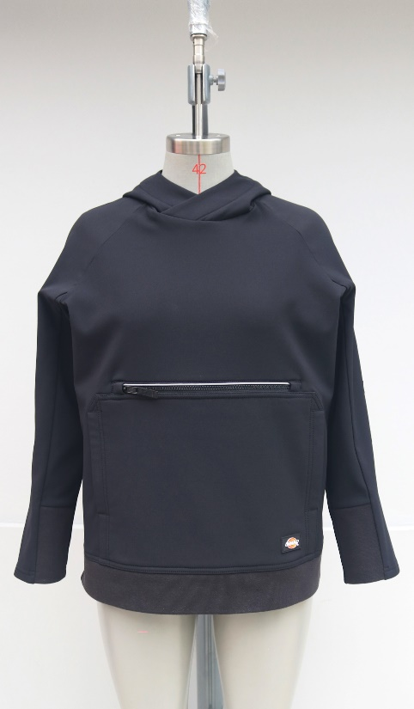
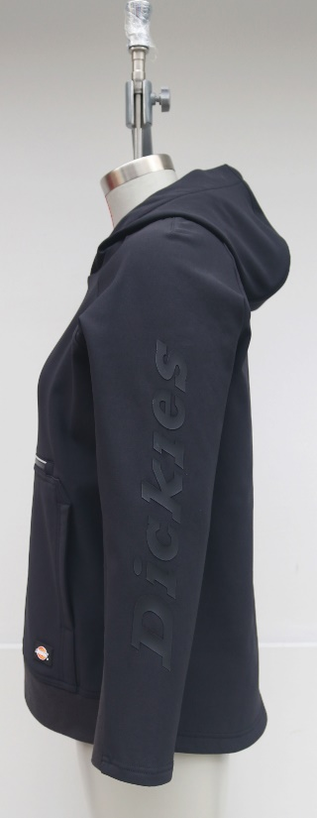
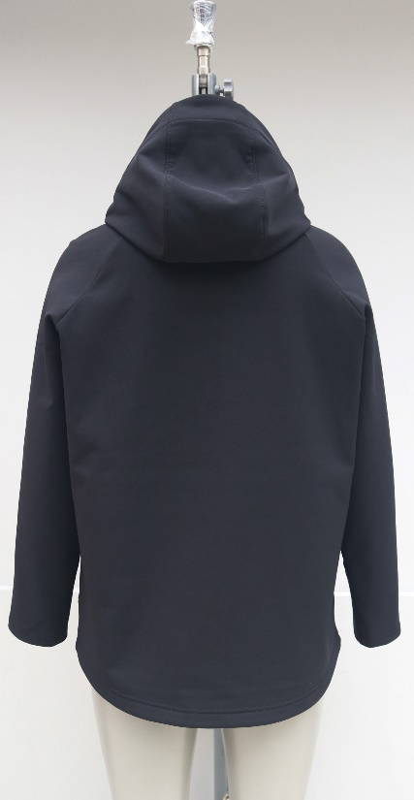
PRODUCT DETAILS
Buyer: Dickies
Style: TW701
Fabric: 310 GSM 93% POLYESTER / 7% ELASTANE DOUBLE FACE DOBBY W/ WARP STRETCH, BACKSIDE BRUSH, PFC FREE DWR

Slide 3
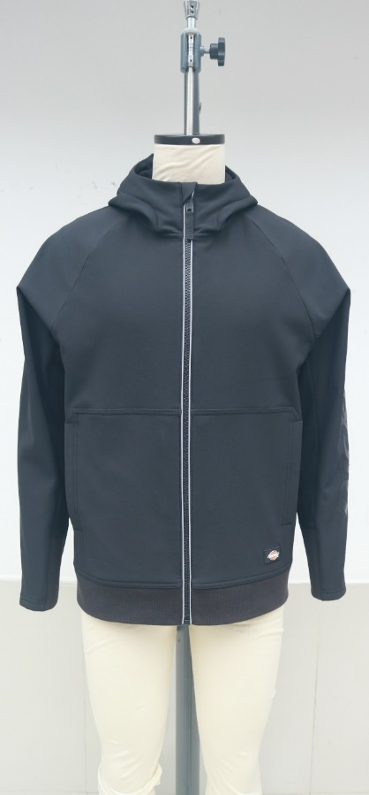
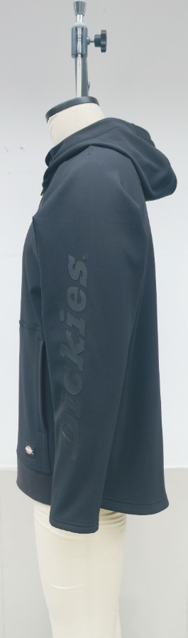
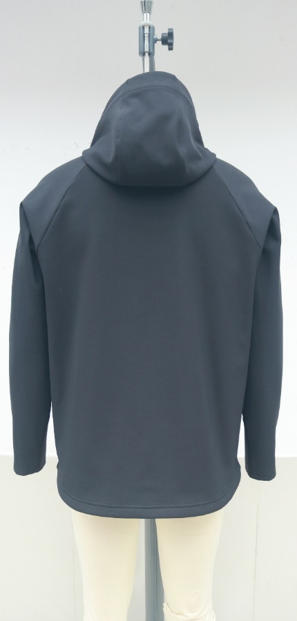
PRODUCT DETAILS
Buyer: Dickies
Style: TW702 (M DICKIES Protect FULL ZIP HOODIE)
Fabric: 310 GSM 93% POLYESTER / 7% SPANDEX DOUBLE FACE DOBBY WITH WARP STRETCH, BACKSIDE BRUSH, PFC FREE DWR

Slide 4
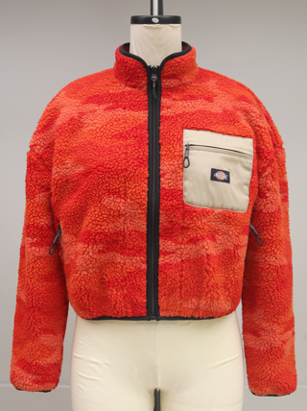
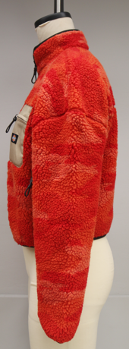
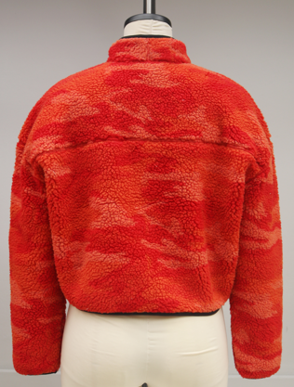
PRODUCT DETAILS
Buyer: Dickies
Style: Red Chute Sherpa W
Fabric: POPCORN SHERPA 2 (FLF3609), LIGHT 66 CLOTH REC- 2974 / D9351(D60976C

Slide 5
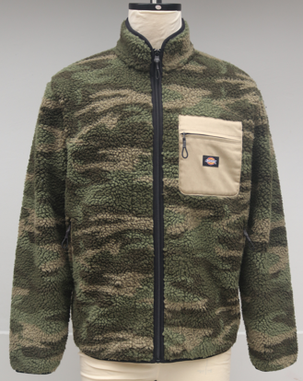
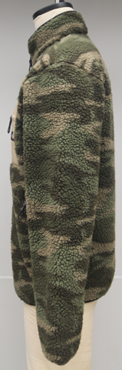
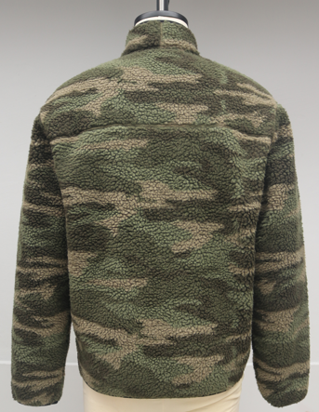
PRODUCT DETAILS
Buyer: Dickies
Style: Style: Red Chute Sherpa
Fabric: POPCORN SHERPA 2 (FLF3609), LIGHT 66 CLOTH REC- 2974 / D9351(D60976C)

Slide 6
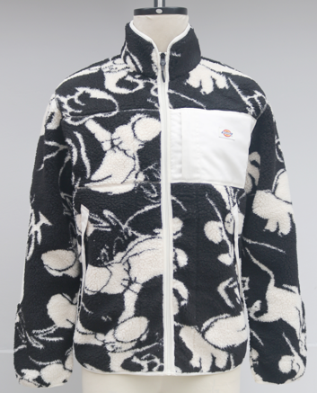
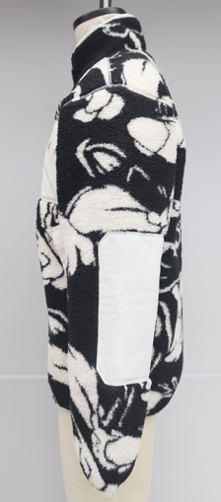
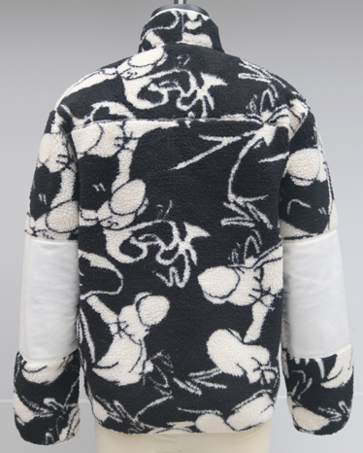
PRODUCT DETAILS
Buyer: Dickies
Style: Falkvilly Sherpa
Fabric: Popcorn Sherpa 2 jacquard EU9008B (FLF3561), 66 Cloth REC (D60796C)

Slide 7
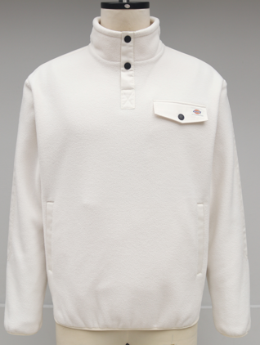
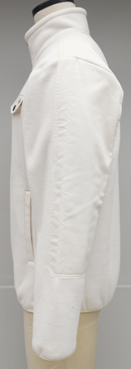
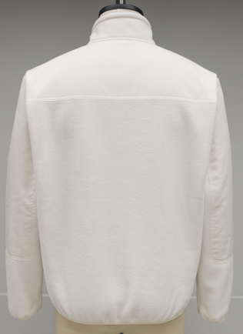
PRODUCT DETAILS
Buyer: Dickies
Style: Camden Fleece
Fabric: Basic polar fleece rec (KTF155-PFZ93), Light 66 Cloth REC- 2974 / D9351 (D60796C)

Slide 8
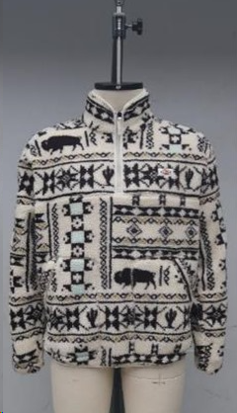
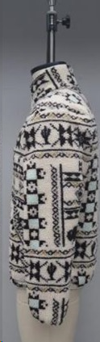
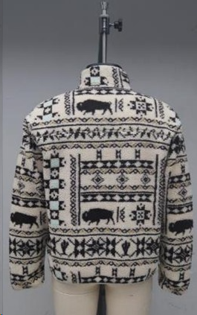
PRODUCT DETAILS
Buyer: Dickies
Style: Hays Quarter Zip
Fabric: 100% Polyester, Popcorn Sherpa 2 jacquard EU9008B

Slide 9
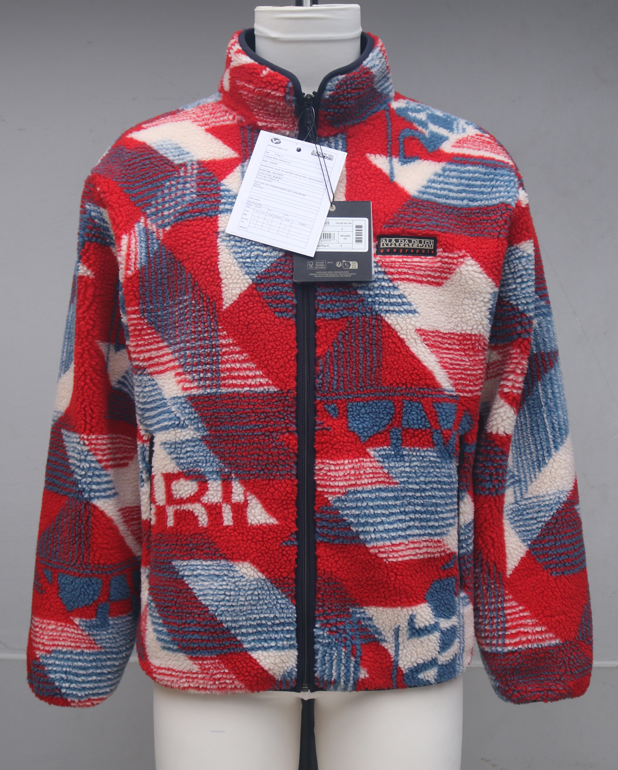
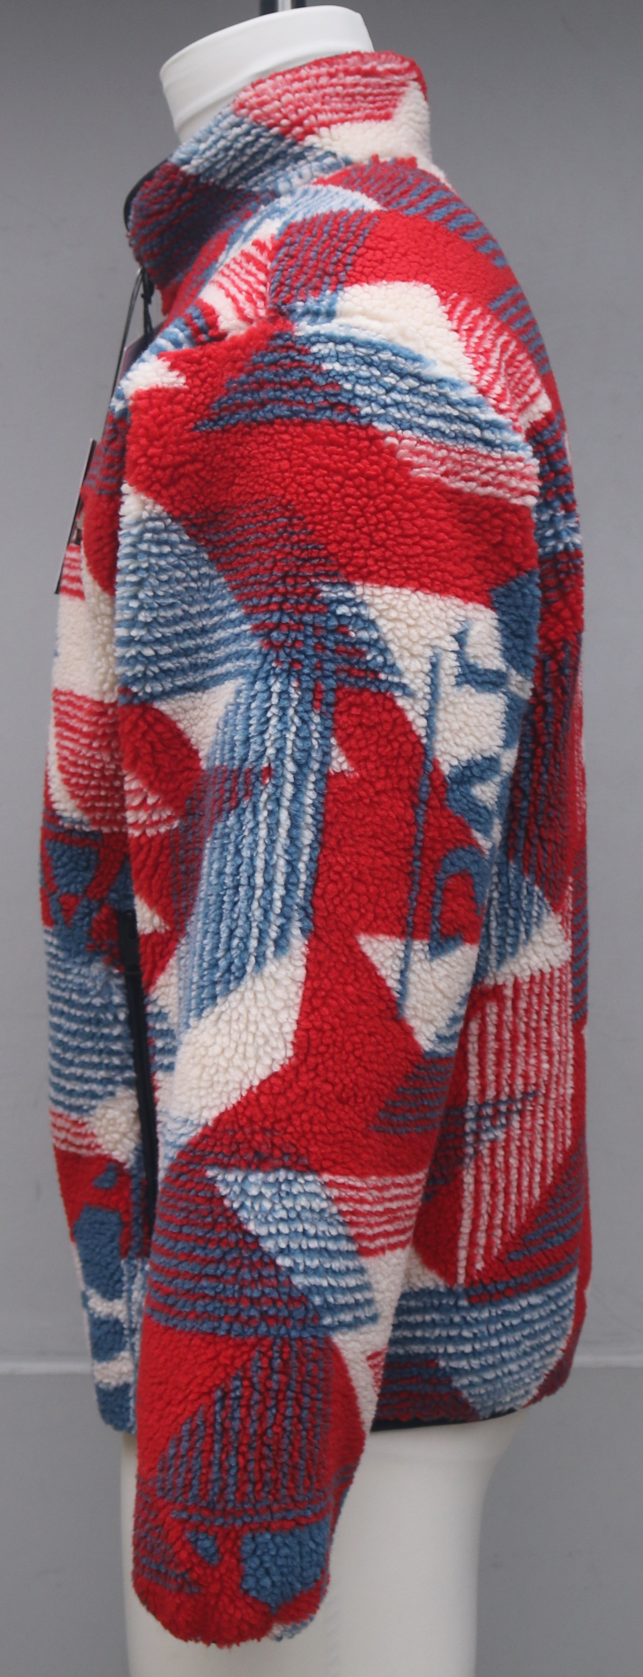
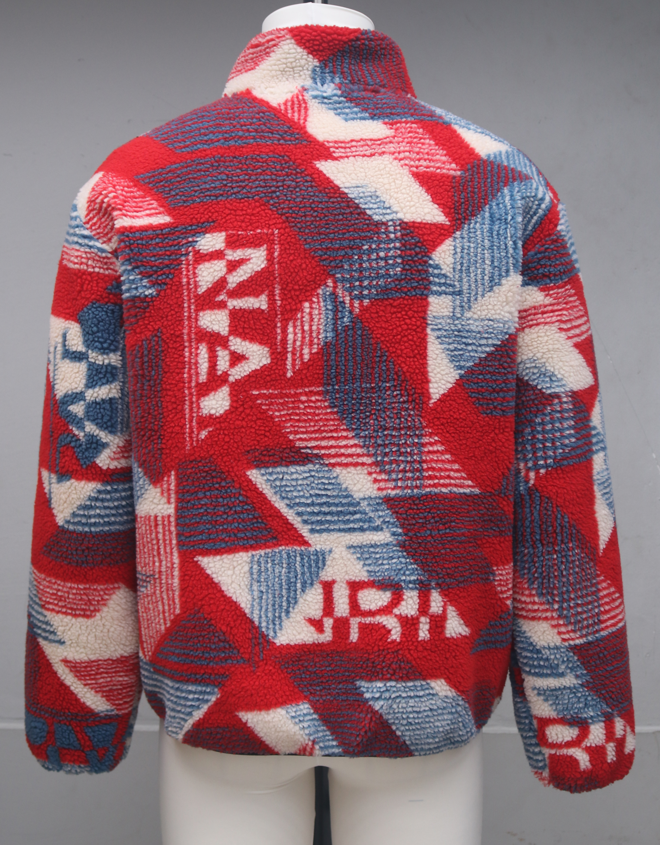
PRODUCT DETAILS
Buyer: Napapijri
Style: T-ARGIENT
Fabric: RH MICRO CURLY JACQUARD REC 100% PL-Actual color and Quality

Slide 10
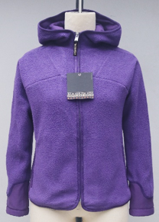
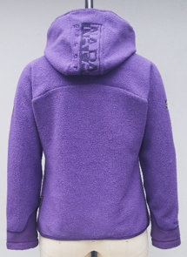
PRODUCT DETAILS
Buyer: Napapijri
Style: Yupik W 2.0
Fabric: Light Mini Curly Recycle 100% Polyester

Slide 11
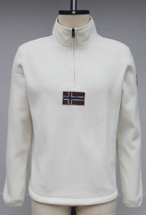
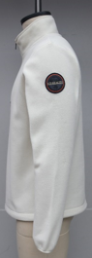
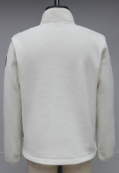
PRODUCT DETAILS
Buyer: Napapijri
Style: TEV HZ FLAG 1
Fabric: Ceramic Polar Recycle 100% Polyester

Slide 12
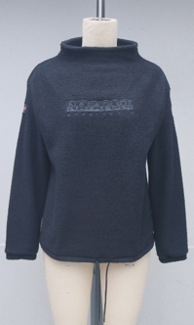
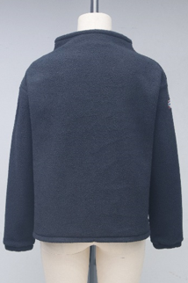
PRODUCT DETAILS
Buyer: Napapijri
Style: Teide W 2.0
Fabric: Light Mini Curly Recycle 100% Polyester

Slide 13
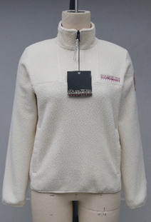
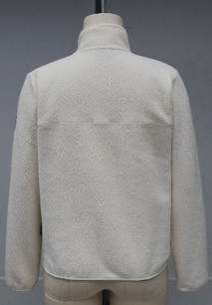
PRODUCT DETAILS
Buyer: Napapijri
Style: T-Cuverville HZ W
Fabric: Rocky Fleece Recycle 100% Polyester

Slide 14
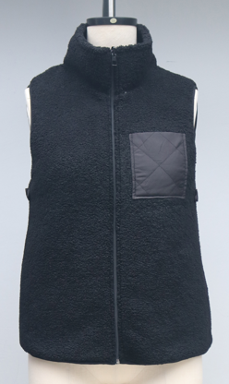
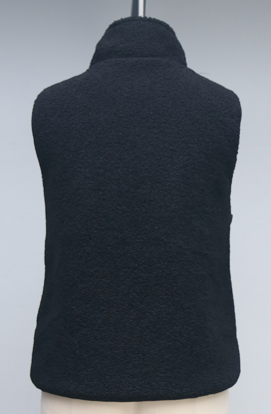
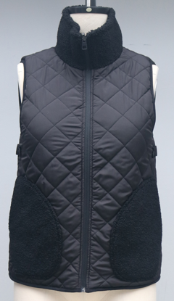
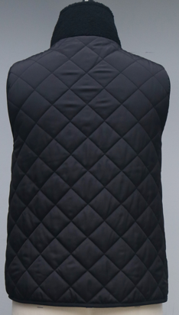
PRODUCT DETAILS
Buyer: Tom Tailor
Style: 1020972 - Reversible Teddy Vest
Fabric: 100% Polyester Fake Fur & 100% Polyester 300T

Slide 15
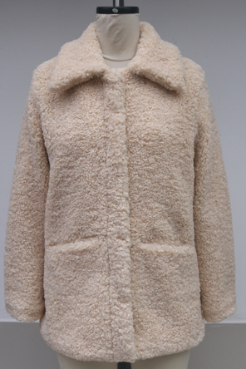
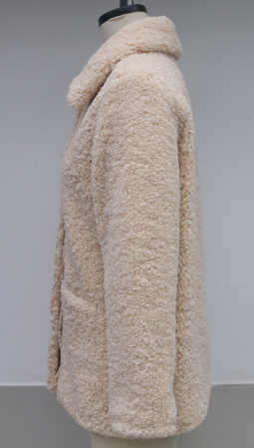
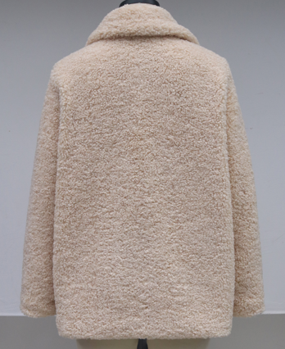
PRODUCT DETAILS
Buyer: Tom Tailor
Style: 1027030 - Teddy Jacket
Fabric: 100% Polyester Teddy

Slide 16
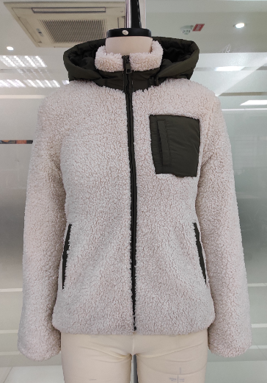
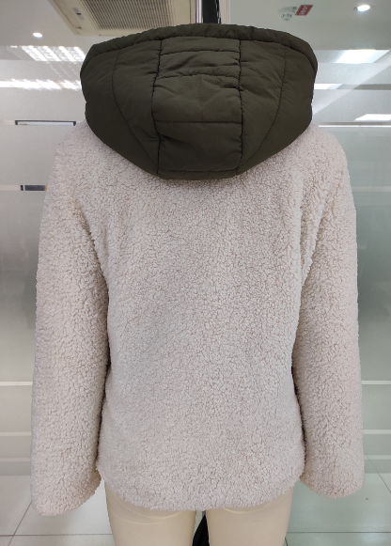
PRODUCT DETAILS
Buyer: Tom Tailor
Style: 1020979 - Teddy Jacket with Hood
Fabric: 100% Polyester Teddy

Slide 17
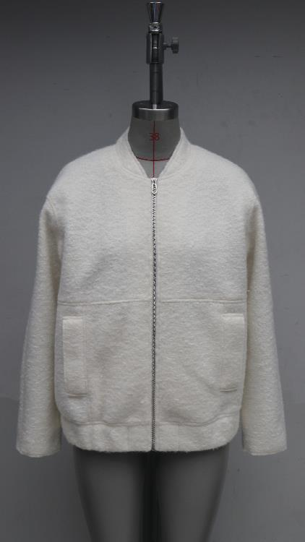
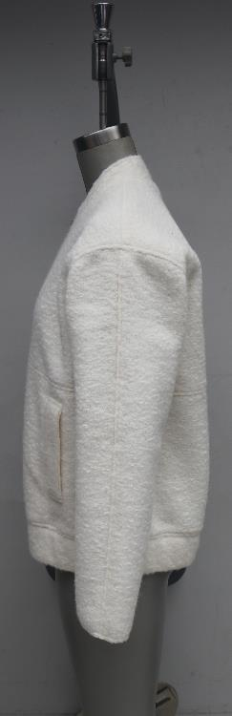
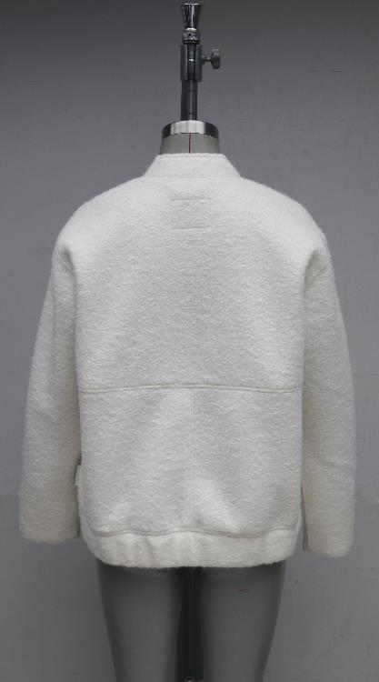
PRODUCT DETAILS
Buyer: Tom Tailor
Style: 1040647
Fabric: FB- CKN- 20009, 100% Polyester

Slide 18
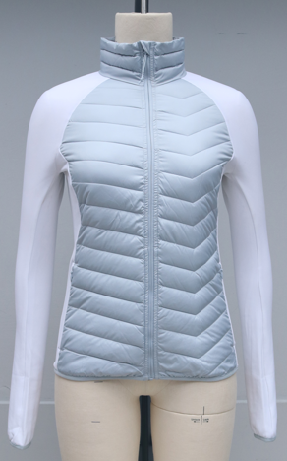
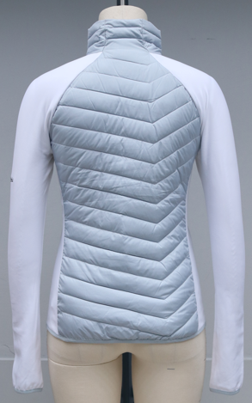
PRODUCT DETAILS
Buyer: Columbia
Style: EK0056
Fabric: 100% Polyester Omni-Shield Storm Lite DP, Dull Face & 60% Polyester, 35% Nylon, 5% Elastane New Honeybee Smooth Face Fleece

Slide 19
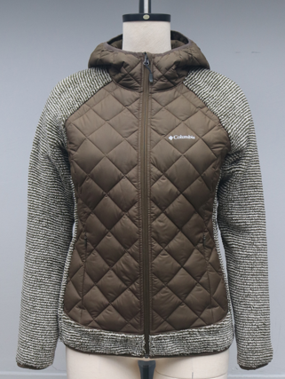
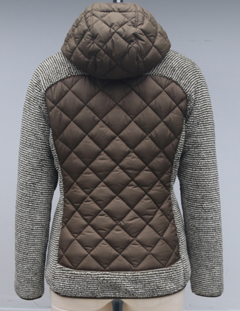
PRODUCT DETAILS
Buyer: Columbia
Style: EL1031
Fabric: 100% Polyester Omni-Shield Storm Lite DP, Dull Face & 100% Polyester EU High Pile Tech Fleece

Slide 20
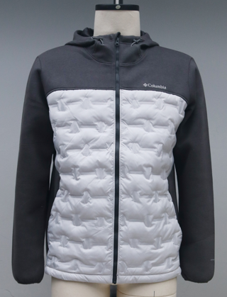

PRODUCT DETAILS
Buyer: Columbia
Style: AO0771
Fabric: 100% Polyester Thermo Trek OHR Windbreaker Heat Seal Water Repellent & 100% Cotton Jersey Heather Faced/Solid, Back Spacer Knit

Slide 21


PRODUCT DETAILS
Buyer: Columbia
Style: AG0055
Fabric: 100% Polyester Bonded perforated face fleece, Embossed & 100% Polyester Windbreaker Bonded Baffle 2 inch Width

Slide 22


PRODUCT DETAILS
Buyer: Only & Sons
Style: Ons Mateo AOP Sherpa Jacket
Fabric: 100% Polyester Sherpa

Slide 23


PRODUCT DETAILS
Buyer: Only & Sons
Style: Ons Fernando Mix Sherpa
Fabric: 100% Polyester Sherpa

Slide 24

THANK YOU

